Slide 1
Getting started with OSGi
Rahul Agarwal
What is OSGi
Demo App
Implementation
Q&A

Slide 2
What is OSGi
Modular framework
Modules are known as “bundles”
Container that manages the life-cycle of these bundles
Provides a mechanism for bundles to share classes and services (SOA in container)
Eg: Equinox, Felix, Knoplerfish

Slide 3
What are Bundles
A JAR file with a special Manifest.mf file
Each bundle has its own ClassLoader (isolation within same JVM)
May “export” and “import” packages to/from other bundles
Bundles may provide/use services to/from other bundles

Slide 4
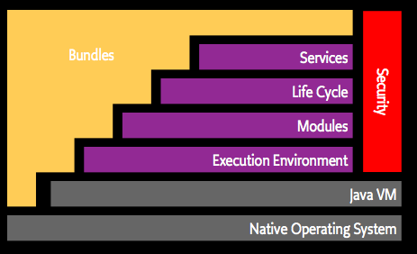
OSGi Layering
Source: http://www.osgi.org/About/WhatIsOSGi

Slide 5
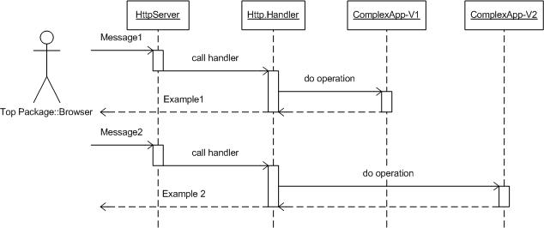
Demo App

Slide 6
Q&A
Download source/blog: http://iRahul.com

